Slide 1
CLASS 5 and 6
Dated 29 th JANUARY , 2025
Course Title: 5G and Wireless Technology
Course Code : ECE829
5G Architecture
Prof.(Dr.) Rabindranath Bera (Professor, IIIT, KALYANI)
E-mail: rbera@iiitkalyani.ac.in; Mobile : 9475513358

Slide 2
Outline of Presentation
Overview of 5G Network and Architecture with Open and Virtualized RAN
Industrial Review
QUALCOMM DEMO : https://www.youtube.com/watch?v=e3Ad05I3LZU
Transcript
5G Architecture
5G Architecture ( BASIC)
5G Architecture ( with O-RAN and V-RAN)
5G O-RAN / V-RAN Architecture Implementation by QUALCOMM
5G O-RAN / V-RAN Architecture Implementation by IIIT, KALYANI

Slide 3
Outline of Presentation
Overview of 5G Network and Architecture with Open and Virtualized RAN
Industrial Review
QUALCOMM DEMO : https://www.youtube.com/watch?v=e3Ad05I3LZU
Transcript
Detailed 5G Architecture

Slide 4
TRANSCRIPT : Mobile World Congress MWC 2023 and today I have with me Durga maladi who is the senior vice president and general manager of modem and infrastructure at Qualcomm Technologies. Firstly Durga welcome thank you for being with me today this week at mwc. Qualcomm made several announcements focused on cellular infrastructure. How has qualcomm's infrastructure portfolio evolved to drive the development of the modern 5G Network. first of all very What is Qualcomms evolving infrastructure portfolio excited to be here and talking about infrastructure ask Qualcomm we made our very first announcement on the latest portfolio of solutions and infrastructure from us back in October of 2020. our message and our Focus has been to bring in cutting-edge high performance radios in both the DU and the ru portions of the solution in infrastructure space . the DU stands for the distributed unit and the ru is the radio unit these are two components that make up the foundational building blocks for infrastructure we feel that a cloud native architecture is needed in infrastructure as we head towards the next generation of where 5G is evolving as a part of that . we made a lot of announcements over the last two years but at this show we are bringing these products out here in the open and talking about all the key benefits that these products bring to the table it's Best in Class power and performance Cutting Edge radio Products on display and these are displays of some of the things that we talked about in our announcements. we have an entire distributed unit right here which runs at 200 megahertz and 16 layers this is something that we promised back about two years back that's on display right behind us along with a very low power consumption at 100 megahertz. we are at somewhere between 16 to 18 Watts they have 64 TR ,64 transmit and 64 received massive mimo radios the solution is on display over here and it's being displayed in a demonstration where we show 16 layers with four devices each with four layers each again Cutting Edge performance finally. In addition to the DU and aru space we made another announcement late last year on what we call as the compact macro solution this is a millimeter wave product which transmits at a very high transmit Power 60 dbm extending the range of millimeter wave but still keeping an extremely small form factor that's also on

Slide 5
displays over here it has the same form factor as a Wi-Fi access point but at the same time has very long range associated with it very powerful products and we are working with the entire ecosystem all of our partners to make sure that these come to commercialization we've seen several Strategic collaborations strategic collaborations between Qualcomm Global operators and ecosystem players over the past few months how is this how to accelerate open Rand Innovation and what are some of the benefits operators are realizing from them we've made a lot of announcements with our partners in the last two years but I'm going to actually cherry pick a few of them on the server space we are working closely with HP and Dell on the infrastructure vendors we are working with NEC Fujitsu mavenir rocket and Symphony vehicle just to name a few we're working with several others but with all these Partners our modern RS platforms are the foundational building blocks but a lot of the infrastructure Partners still have to do additional work in writing their layer 2 and layer 3 software and that makes it into a complete product as a part of these announcements we are working with several operators and in these operators what they are interested in is post these demonstrations and the lab tests we expect to see action on the ground in the field showcasing the technology showcasing what Oran compliant Solutions are really capable of when it comes to high performance radios and very energy efficient radios on top of it so we hope to prove this out into the field this year leading towards commercialization as we go along looking forward how is the growth Growth strategy strategy of Qualcomm Poe is to drive the full-scale commercialization of open virtualized brand from a general Qualcomm strategy when Cristiano took over as our CEO he made it very clear that we want to be in the business of diversifying our products into a large number of segments part of the diversification strategy is not only to expand on devices these days when we talk of devices we go from handsets compute segment fixed wireless access XR and going all the way into iot and Automotive domain but we want to bring in that Innovation onto the network side of the equation as well and that's where our diversification strategy really helps when we have a role not by being a full-fledged infrastructure vendor but by doing our part in having a horizontal platform on which our partners can build the radio Solutions as we move forwards we expect to see a larger portfolio of products coming into the mix as we grow from where we are today towards commercialization look thanks so much Outro for that very enlightening and it's great to see Qualcomm heading up such a fabulous ecosystem thank you thanks for having me

Slide 6
Outline of Presentation
Overview of 5G Network and Architecture with Open and Virtualized RAN
Industrial Review
QUALCOMM DEMO : Transcript
5G Architecture
5G Architecture ( BASIC)
5G Architecture ( with O-RAN and V-RAN)
5G O-RAN / V-RAN Architecture Implementation by QUALCOMM
5G O-RAN / V-RAN Architecture Implementation by IIIT, KALYANI

Slide 7
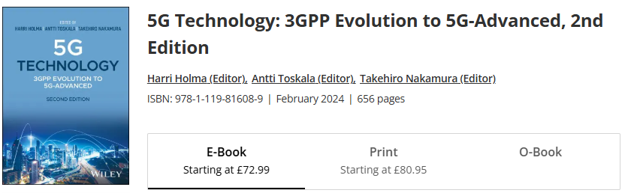
Chapter 5
5G Architecture
**The Softcopy of above BOOK will be uploaded in Classroom
*** Interested Teachers/Faculty should consult this Book on Requirement

Slide 8
*IIIT, KALYANI 5G LAB Set up has only 5G SA Architecure [ Left Side Figure]

Slide 10
5G RAN Architecture
The 5G radio access architecture consists of two basic elements as follows:
• Central Unit (CU), which is intended to handle relatively higher layers above the physical layer. The physical realization of CU could be either dedicated hardware or a radio-cloud type of implementation. The CU is connected on one hand to the Distributed Unit (DU) and on the other hand to the 5G core network (Next Generation Core (NGC), as shown in Figure 5.5.
• The DU, which is located on the cell site together with the antennas and the RF unit.
The DU is expected to handle especially time-critical processing which does not tolerate too much delay to enable processing away from the cell site.
In the considerations in 3GPP, the approach with RF only on the site (with antennas)has not been considered desirable due to the very high transmission requirements of sending IQ samples. Although such an approach was used in some markets with LTE, the larger number of antennas as well as the larger bandwidths considered make the required data rates so massive that they are not often seen in large-scale network deployments.

Slide 11
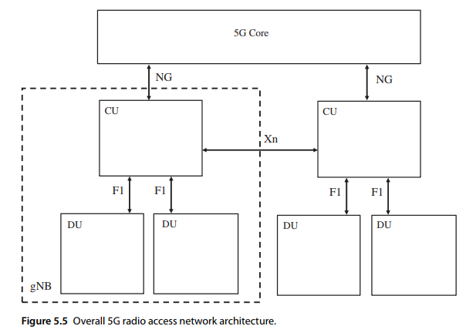

Slide 12
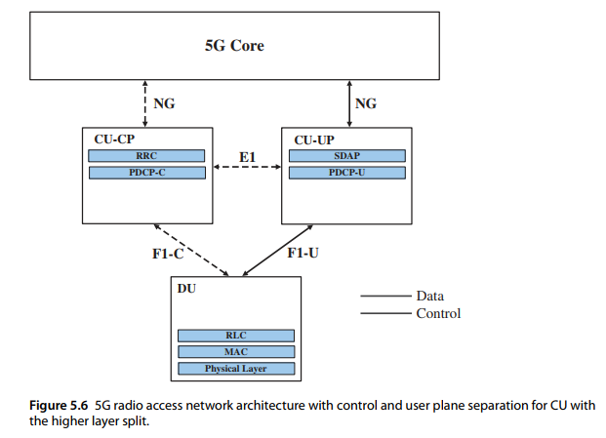
RLC .. Radio Link Control
MAC ...Medium Access Control
RRC Radio resource control
PDCP Packet Data
Convergence Protocol
SDAP - Service Data Adaptation
Protocol

Slide 13
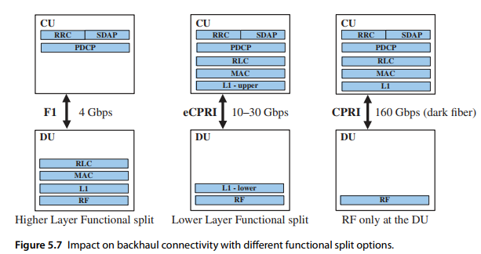

Slide 14
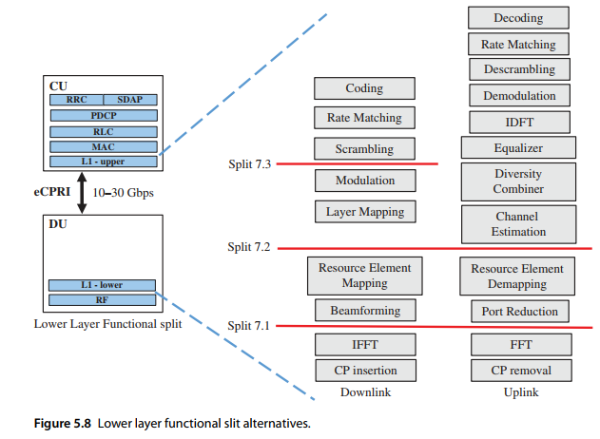
*IIIT, KALYANI 5G LAB Set up has Split 7.2 Option

Slide 15
Outline of Presentation
Overview of 5G Network and Architecture with Open and Virtualized RAN
Industrial Review
QUALCOMM DEMO :
Transcript
5G Architecture
5G Architecture ( BASIC)
5G Architecture ( with O-RAN and V-RAN)
5G O-RAN / V-RAN Architecture Implementation by QUALCOMM
5G O-RAN / V-RAN Architecture Implementation by IIIT, KALYANI

Slide 16
Chapter 20
Open RAN and Virtualized RAN
Harri Holma and Antti Toskala
Nokia, Finland

Slide 17
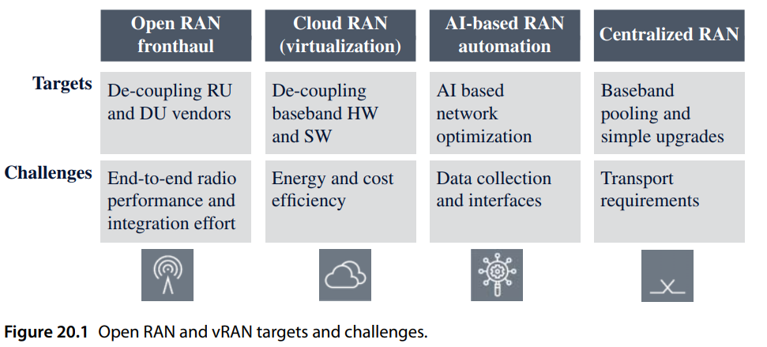
( DU and CU Vendors )

Slide 18
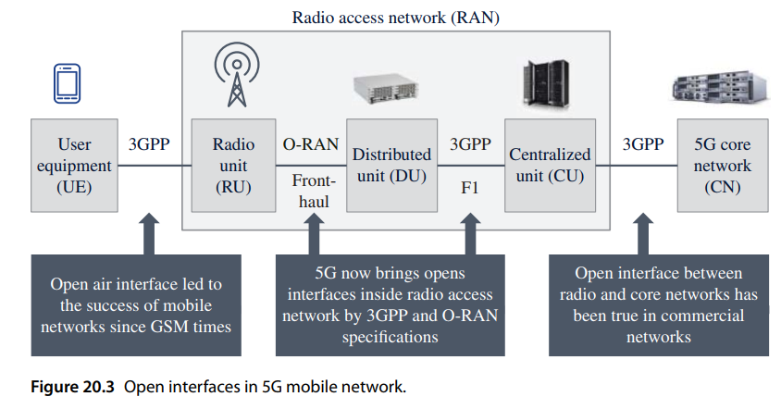

Slide 19
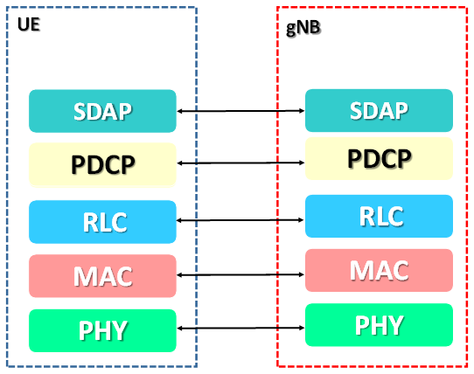

Slide 21
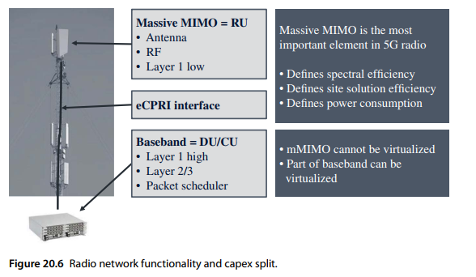

Slide 22
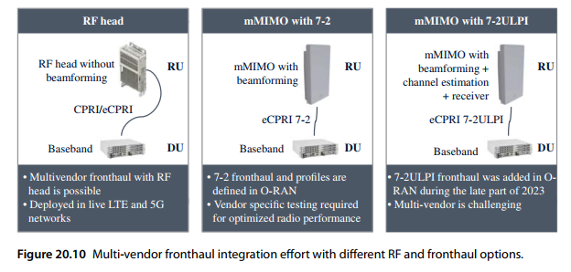

Slide 23
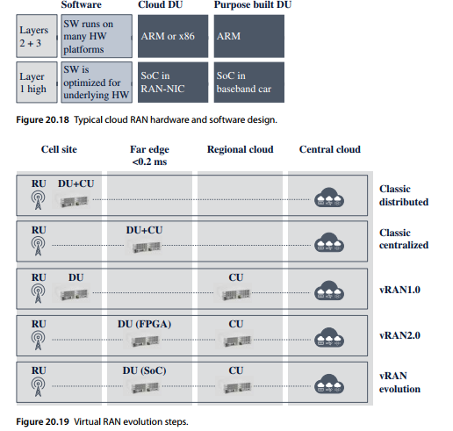

Slide 24
Outline of Presentation
Overview of 5G Network and Architecture with Open and Virtualized RAN
Industrial Review
QUALCOMM DEMO :
Transcript
5G Architecture
5G Architecture ( BASIC)
5G Architecture ( with O-RAN and V-RAN)
5G O-RAN / V-RAN Architecture Implementation by QUALCOMM
5G O-RAN / V-RAN Architecture Implementation by IIIT, KALYANI

Slide 25








Slide 26



























































Slide 27










Place processing and analytics where it is needed
Simplify orchestration
Support different deployment scenarios
Resource pooling allows trunking gains and better cost and energy effectiveness
Rapidly scale virtual resources for additional capacity
Higher utilization of scalable resources
Deploy networks faster
with vRAN and
disaggregation
Support lower
end-to-end latency
Components can evolve and be upgraded separately
Open vRAN
Efficiently deploy new services
Tailor dimensioning and features to suit the use case with 5G private networks
Reduce cell-site footprint by relocating disaggregated functions to data centers
Real Estate
Savings
Broaden the
ecosystem for competition
Build RAN cost-effectively
Vendor diversity spurs innovation
3

Slide 28


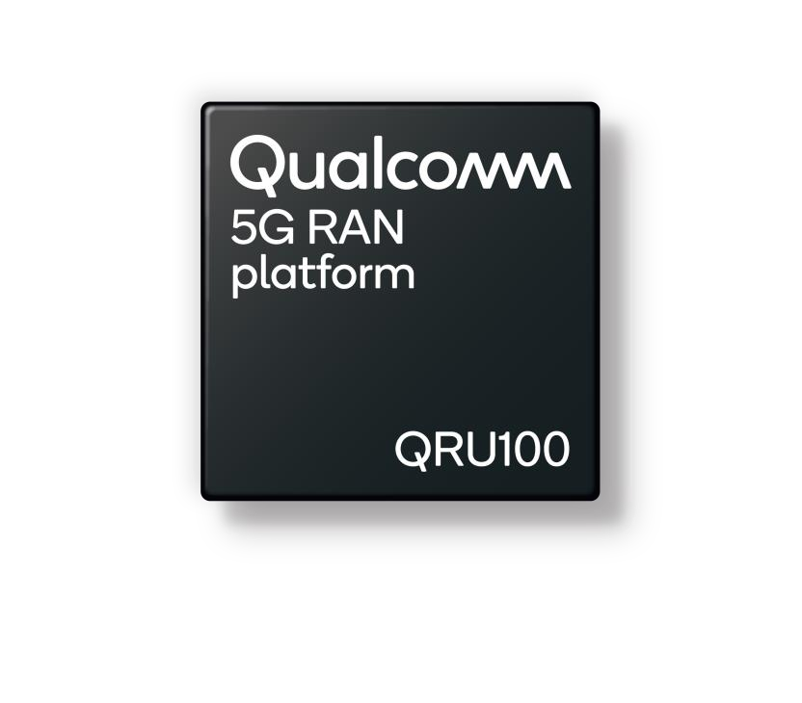
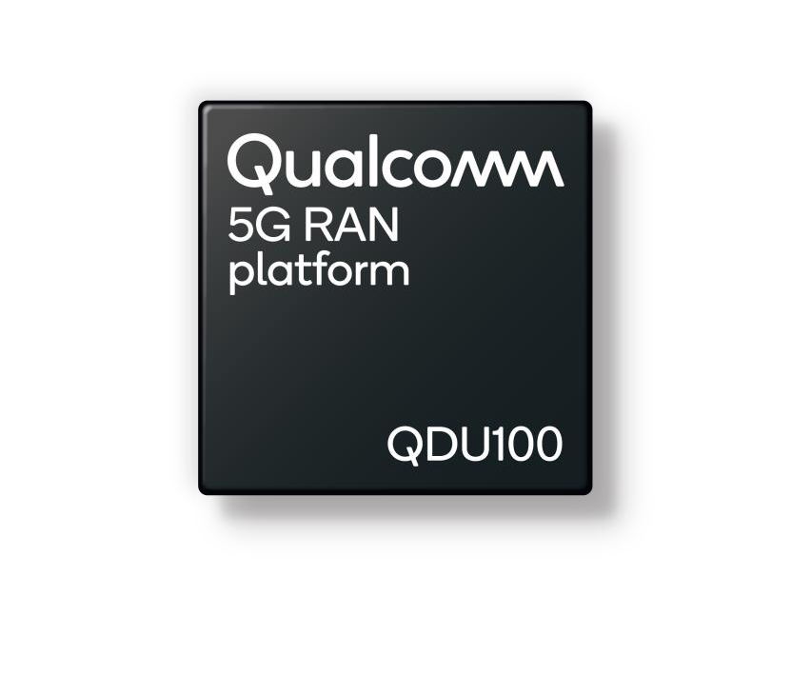
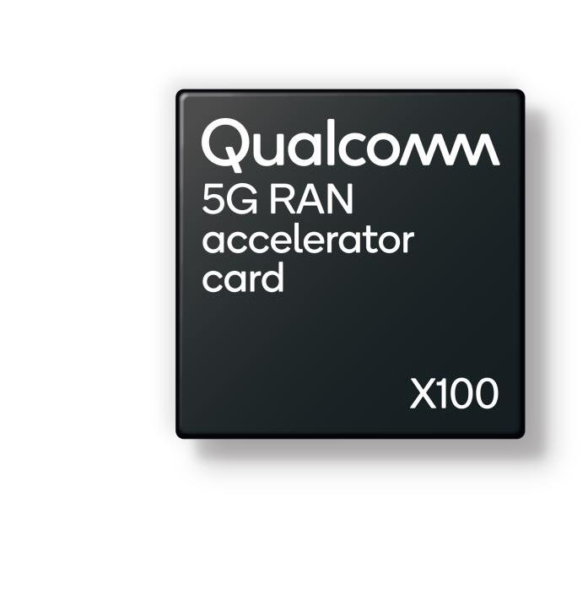




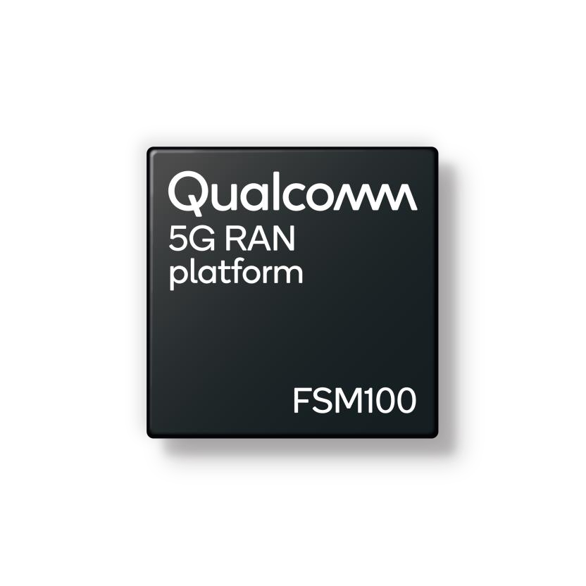





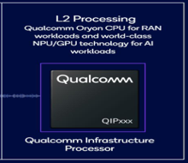



RADIO UNIT
DISTRIBUTED
UNIT
DU in ACC CARD
CODING & MODULATION
SMALL CELLS
AI Processor

Slide 29





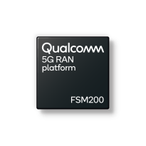

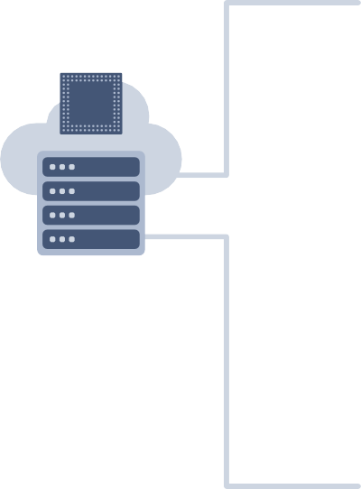


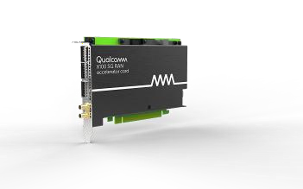



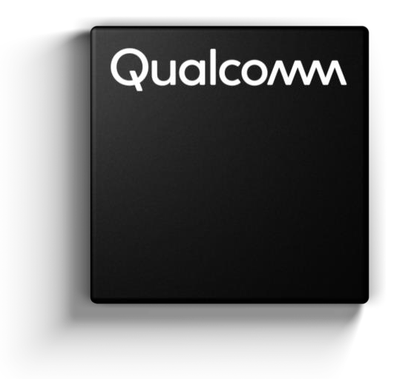





Driving transition to Infrastructure 2.0
Powered by extended portfolio of Qualcomm® 5G RAN platforms
with FOUR PRIVATE CELLS
Standard-based open RAN interfaces
Sub 6 GHz
RADIO
Qualcomm
High-performance Modem-RF System
10101 10101 10101
10100 10100 10100
01010 01010 01010
11010 11010 11010
Virtualized software from multiple vendors
SMALL
CELLs
Internet and 3rd party cloud
Edge data centers
5G-gNB (DU)
with CODING &
MODULATION &
Others
Includes
* 5G CORE
* MEC
General-purpose COTS hardware
EXTREME BROAD BAND using MM Wave RADIO
5G RAN
Platforms
High performance Modem-RF System
Flexible, scalable, O-RAN compatible
vRAN with hardware acceleration
Designed for macro and small cells
Integrated mmWave and Sub-6 GHz solution with
global band support

Slide 30
COMPARE QUALCOMM 5G RAN PLATFORM with INFRA 2.0 with 5G/6G LAB INFRASTRUCTURE , IIIT KALYANI

Slide 31
* 5G FAPI suite ( femto application platform interface)

Slide 32


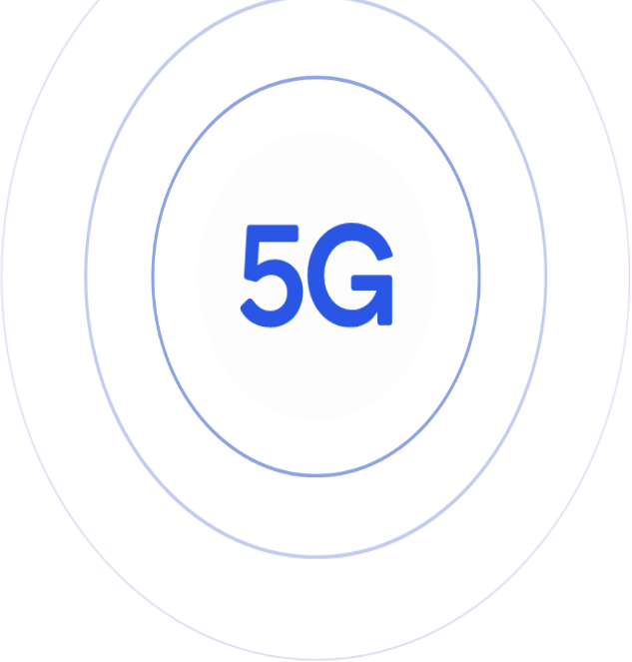








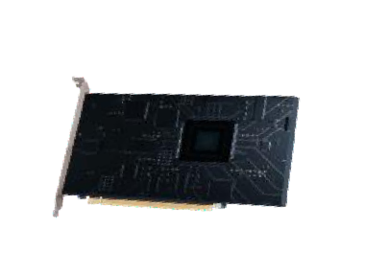












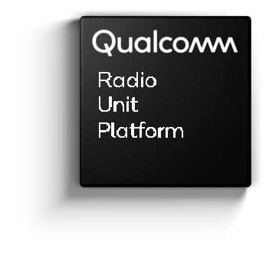











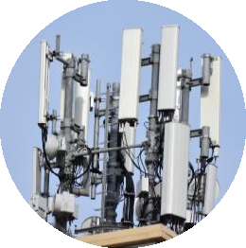
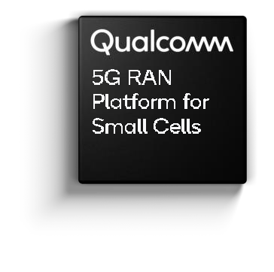











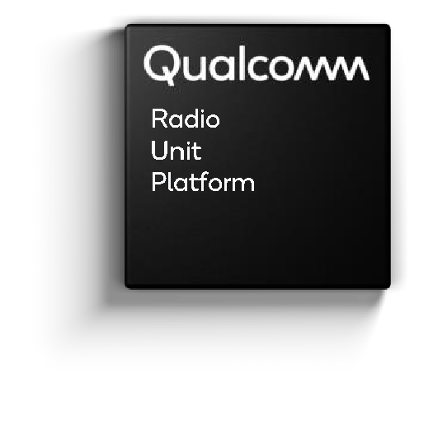



5G Infrastructure 2.0 with PUBLIC & PRIVATE NETWORK ADD-ON
5G OPEN- vRAN PRIVATE NETWORK
ADD-ON
Core Data
Center
RAN Data
Center
RAN Data Center
Small Cells
EXISTING 5G NETWOTK
6

Slide 33













Collaborating with global operators to drive adoption of 5G Open vRAN
7

Slide 34





Driving the evolution to open, virtualized 5G RAN
Announcement recap
Next-generation 5G virtual DU solution
First fully optimized vDU solution with up to 60% lower operator TCO
Solution aims to improve user experiences by helping ready virtualized and open RAN platforms to support the high- capacity and low-latency workloads of future networks.
* Total cost of ownership (TCO)
8

Slide 35
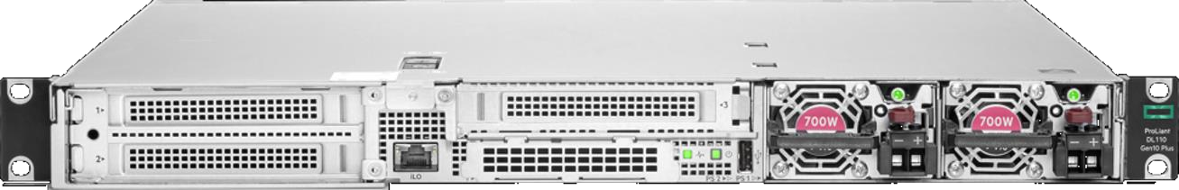

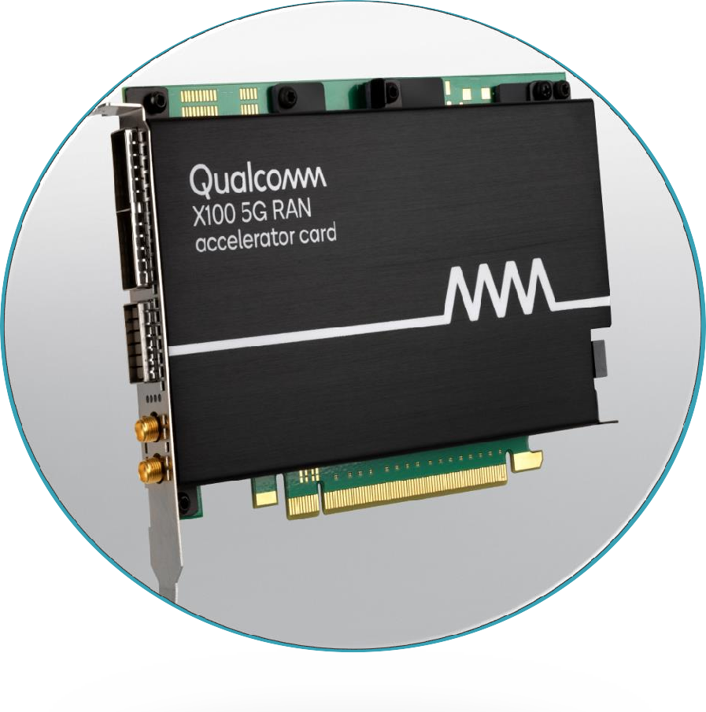



Qualcomm®
HPE ProLiant DL110 Gen10 Plus
X100 5G RAN Accelerator Card
Layer 1 Processing
Demodulation Beamforming Channel coding
Massive MIMO computation
1U server
Up to 4xM.2
NVMe
Front mounting
Front to back
active cooling
Shallow depth 17"
Up to 8 DIMMs
(8–128GB)
4xFHHL x16 PCIe 4.0
Single socket ICX-SP, up to 205W TDP
700W AC/ DC PSU
9

Slide 36
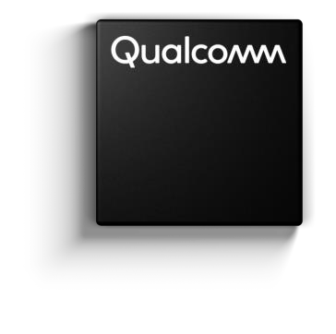






5G RAN
Platform
Next-generation 5G virtual DU solution
up to
up to
60% 40%
First fully optimized vDU solution
Lower Operator TCO
Lower power consumption
Ref : According to a comprehensive joint study by Hewlett Packard Enterprise and Qualcomm Technologies, Inc
10

Slide 37

Driving the evolution to open, virtualized 5G RAN
Announcement recap
Next-generation 5G DUs and RUs with massive MIMO for Open RAN 5G deployments
Solutions to enable the deployment of cloud-native, virtualized, and open 5G networks at scale
Solution Powered by Qualcomm® 5G RAN Platforms is Designed to Simplify Network Deployments, Lower TCO, and Accelerate Adoption of Cloud-Native, Open RAN-Based Mobile Networks Globally
11

Slide 38

Driving the evolution to open, virtualized 5G RAN
Announcement recap
Next-generation 5G DUs and RUs with massive MIMO for Open RAN 5G deployments
Solutions to enable the deployment of cloud-native, virtualized, and open 5G networks at scale
Expanded Open RAN portfolio of 5G Radio Units (RU) spanning categories ranging from mmWave to massive MIMO with 64T64R capabilities to 8T8R radios to drive the transition towards modern networks
12

Slide 39

Driving the evolution to open, virtualized 5G RAN
Announcement recap
Fully-Integrated Open RAN Solution for 5G mmWave
Proliferation
5G mmWave integrated DU and RU for Open RAN 5G deployments
Next-generation mmWave global solution within NTT DOCOMO’s 5G Open RAN Ecosystem (OREC) initiative, ushering in global Open RAN deployments
13

Slide 40
Viettel Launches the World’s First O-RAN 5G Network Utilizing Qualcomm 5G RAN Platforms
Viettel said it will deploy more than 300 sites across various Vietnamese provinces by the first quarter of 2025
Vietnamese telco Viettel announced the commercial launch of its Open RAN (O-RAN) 5G network using a platform provided by Qualcomm Technologies, the company said in a release.
The telco claimed that this is the first O-RAN 5G network utilizing Qualcomm Technologies’ 5G RAN platforms. Viettel said it will deploy over 300 sites across various Vietnamese provinces by the first quarter of 2025, with the potential for thousands more as part of nationwide and international expansion plans in 2025 and beyond, said Viettel.
The deployment utilizes Qualcomm X100 5G RAN Platform for vDUs, Qualcomm QRU100 5G RAN platform for Massive MIMO radio units and integrates the Qualcomm Edgewise Suite for premium RAN management.
https://www.rcrwireless.com/20241114/featured/viettel-qualcomm-5g-o-ran

Slide 41
Outline of Presentation
Overview of 5G Network and Architecture with Open and Virtualized RAN
Industrial Review
QUALCOMM DEMO :
Transcript
5G Architecture
5G Architecture ( BASIC)
5G Architecture ( with O-RAN and V-RAN)
5G O-RAN / V-RAN Architecture Implementation by QUALCOMM
5G O-RAN / V-RAN Architecture Implementation by IIIT, KALYANI

Slide 42
* 5G FAPI suite ( femto application platform interface)

